Slide 1
School of engineering (far western university)
Digital-Clock Simulation

Slide 2
“Learn, lead and grow together”

Slide 3
Team members
Pradip Bhatt
Suna Chaudhary
Yashoda Badu
Santoshi Ayer

Slide 4
CONTENTS
Introduction
Objective
Components used
Implementation
Conclusion
555 Timer IC
Seven segment common cathode
Capacitor
Resistor
Voltage source
Triple 3-input positive AND gate
Seven segment display decade counter

Slide 5
INTRODUCTION
There are several existing clock in the world ; analog and digital. A digital clock is a type of clock that displays the time digitally. In this design, simulation of digital clock is capable of displaying seconds, minutes and 24 hours timing is presented. This simulation consists of 6 digits 2 digit for seconds, two digit for minutes and remaining two digit for hours.

Slide 6
objectives
To build the digital clock successfully gaining all the required knowledge.
To know about the working of each and every component and their role in the circuit
To apply our knowledge and understanding into practice

Slide 7
Components used
555 Timer IC
Seven segment common cathode
Capacitor
Resistor
Voltage source
Triple 3-input positive AND gate
Seven segment display decade counter

Slide 8

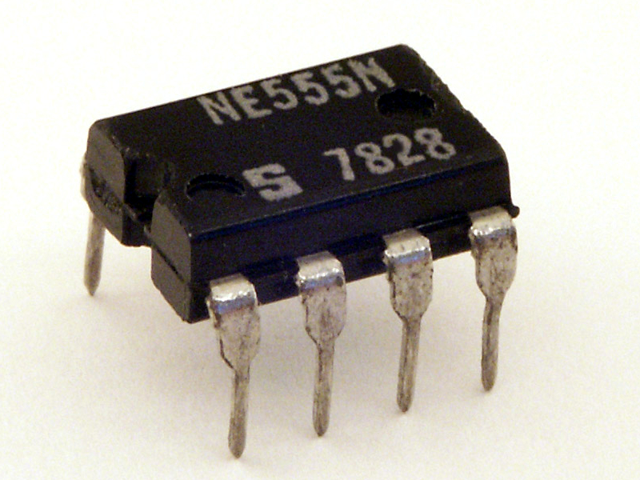
555 Timer IC
555 timer IC is an integrated circuit used in a variety of timer, delay, pulse generation and oscillator applications.

Slide 9

Seven segment common cathode
Seven segment common cathode is an array of 7 LEDs, the LED cathodes are all tied together and are common. This is typical LED display with each LED segment labeled with an alphabetical character.

Slide 10



Capacitor, resistor and voltage source

Slide 11

Triple 3-input positive AND gate

Slide 12

Seven segment display decade counter
Seven segment display consist of seven segments , meaning it consist of seven light emitting diodes or LED’s, which together can be used to form one complete digit on the display.

Slide 13
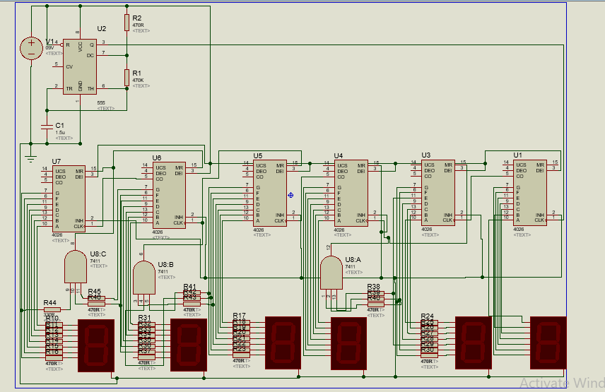
Implementation

Slide 14
conclusion
Thus , this is how our main system has been built up.
More and more knowledge involving the whole system has been gained with time and through more research.
We have complete this project successfully and have successfully made a 24 hours digital clock.

Slide 15
Thank you!
Do you have any questions?

